Slide 1
SharePoint Framework M1 & M2
Jenkins NS
@jenkinsns

Slide 2












Jenkins NS
Modern Workplace Solution Architect | Consultant
15+ Years of experience
Microsoft Teams, Power Platform and SPFx Specialist
International Speaker | Blogger | Trainer
SPS Bangalore Organizer
aOS Ambassador
jenkinsns@gmail.com
in/jenkinsns
@jenkinsns
http://www.jenkinsblogs.com
jenkinsns
https://www.facebook.com/spfxinfo/
https://www.facebook.com/msteamsinfo

Slide 3

Agenda
Module 1: SharePoint Framework Overview
What is SharePoint Framework
Why SharePoint Framework?
Modern toolchain

Slide 4


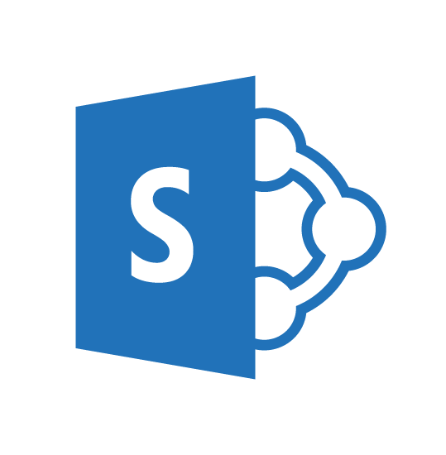
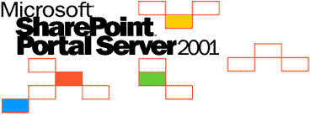
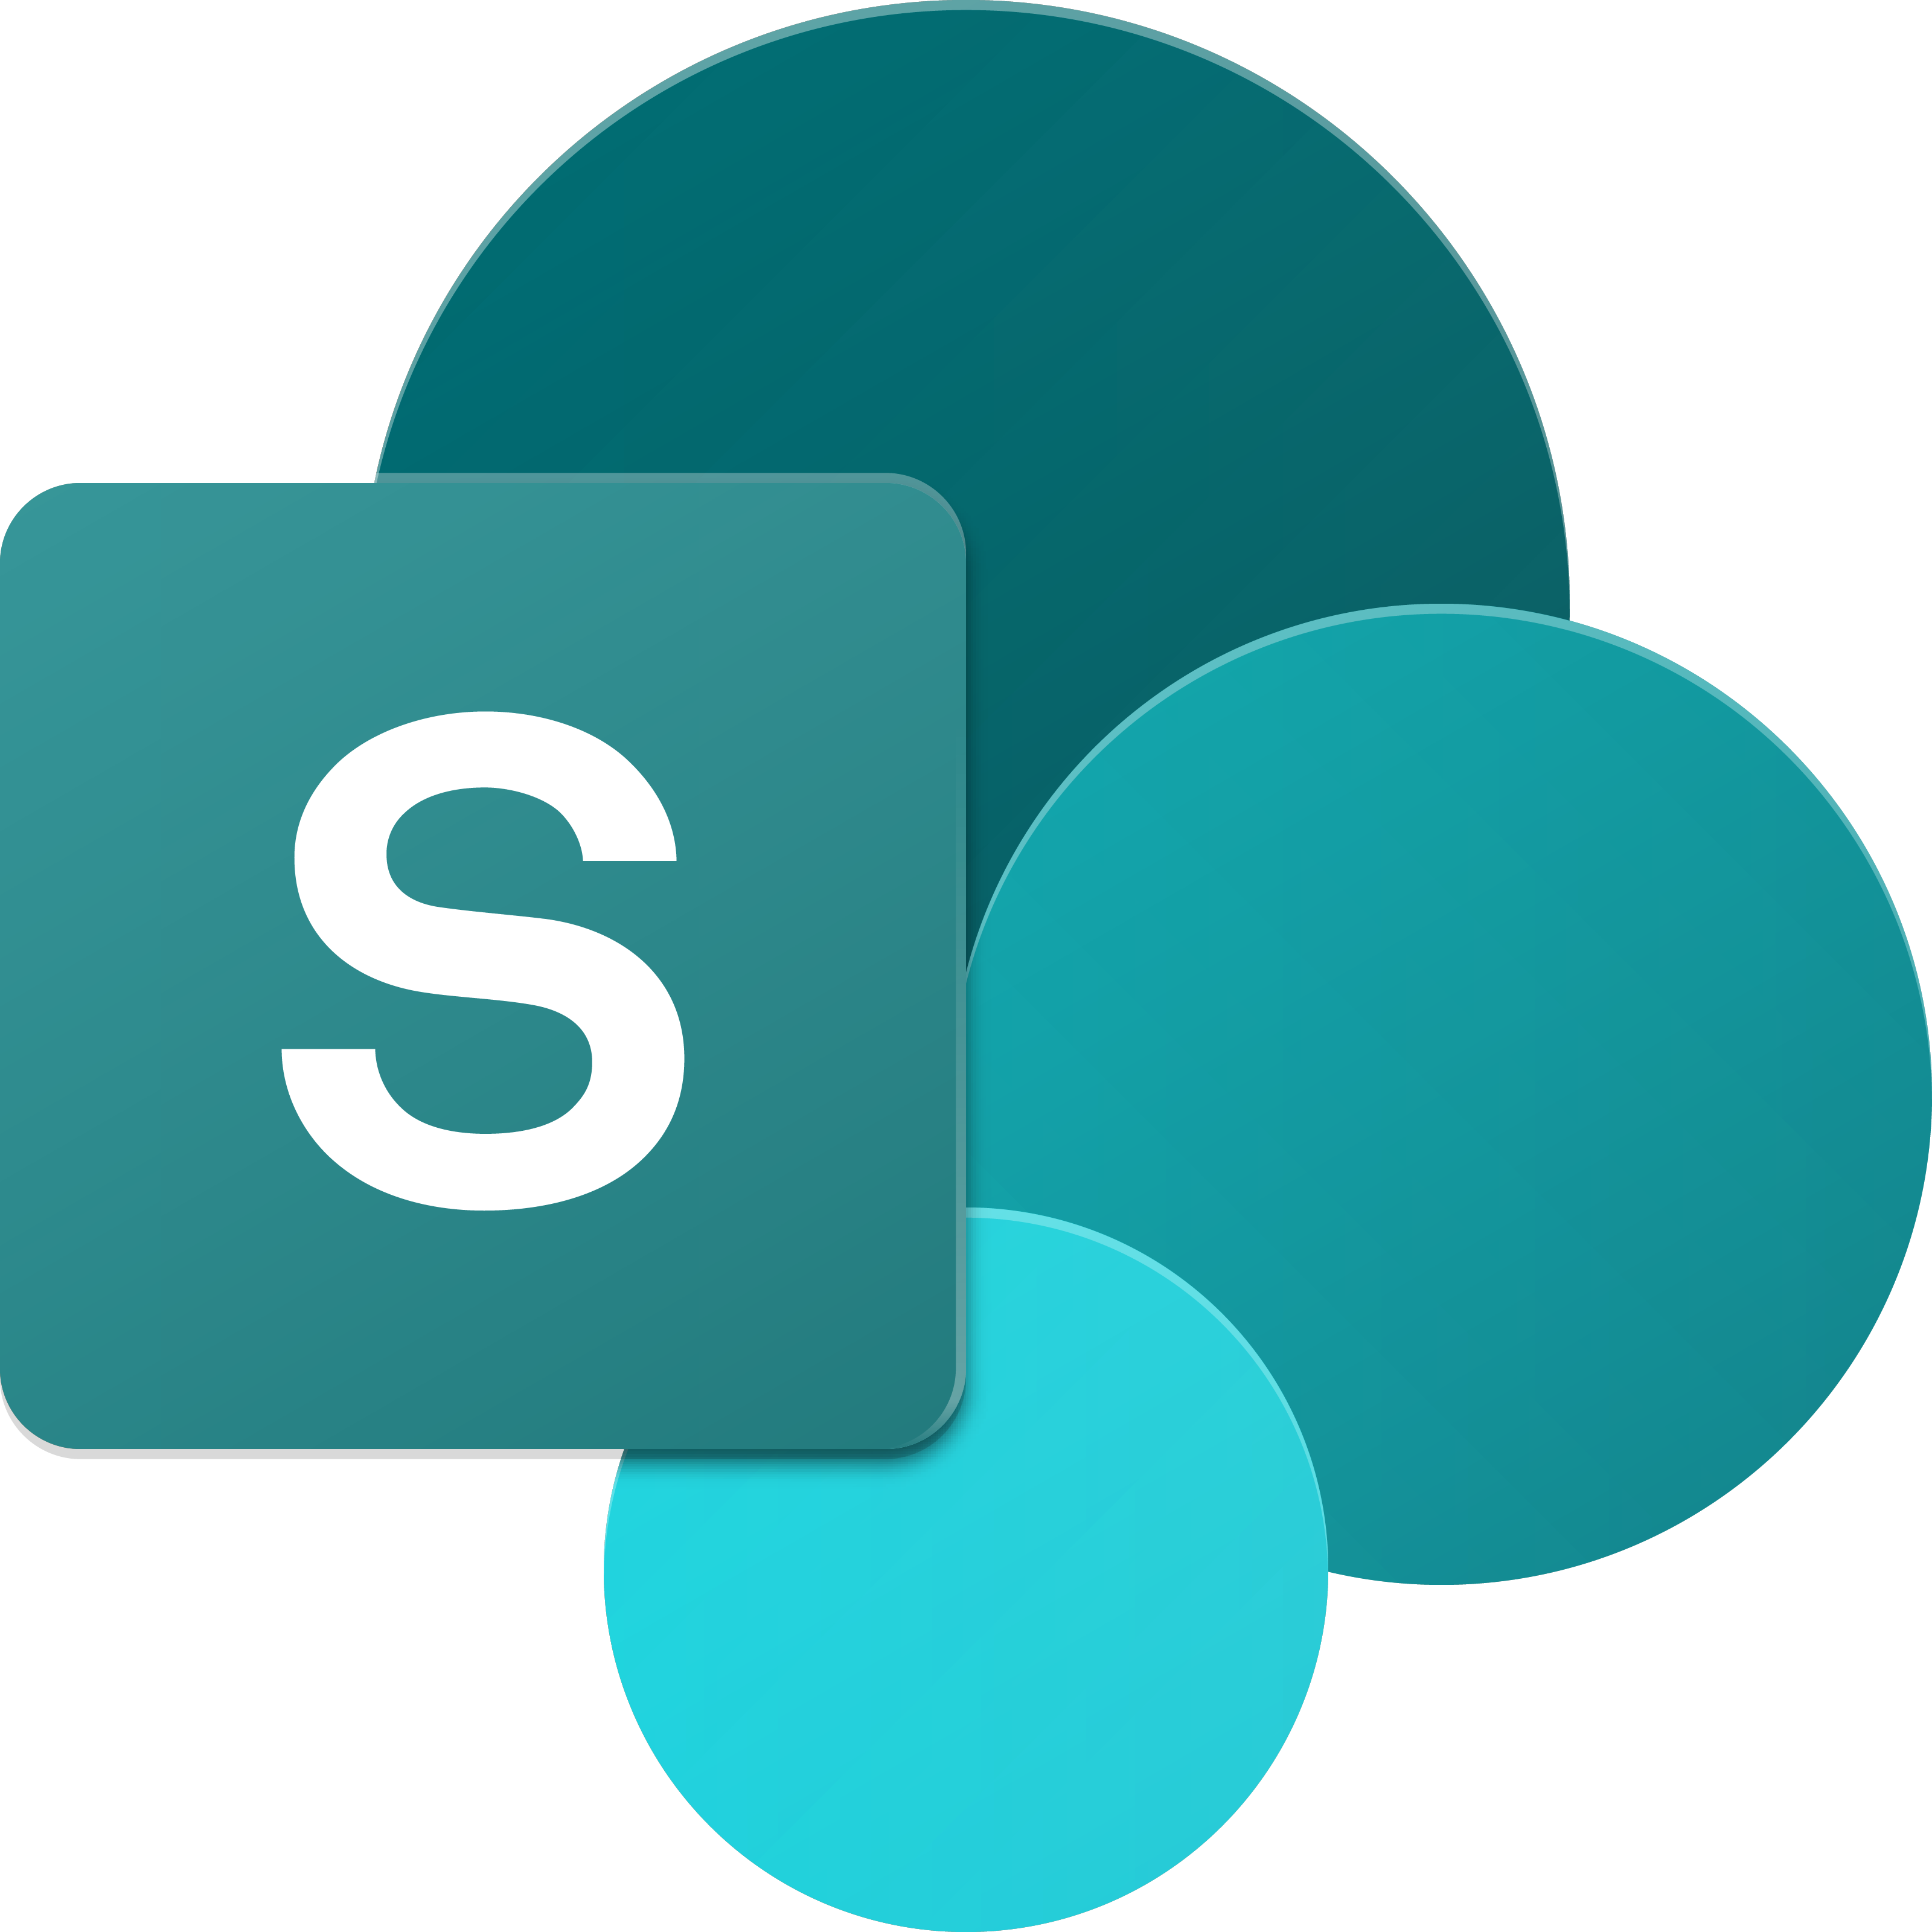
SharePoint UX – Evolving cross versions
SharePoint
Portal Server 2001
SharePoint
Portal Server 2003
Office SharePoint
Server 2007
SharePoint
Server 2010
SharePoint
Server 2013
SharePoint
Server 2016, SPO
2001
2003
2006
2009
2012
2016--19 …
ASP
Early Server Widget Tech
Single Box
ASP.NET
WebParts
CAML
SharePoint Publishing
FAST acquisition
Shared Services (e.g. taxonomy)
First Client-Side Rendering Using XSL
Search driven publishing sites
Client-Side Rendering sprinkled in, e.g. CBS, MDS, etc.
Hybrid
Modern standalone cloud apps, e.g. O365 Video, Delve, etc.
…
Aug 2016
SPFx and Office Fabric
Modern SharePoint pages
Notes:
Tahoe/SPS 2001 – ASP Based, Single Box
SP 2003 – Moved to ASP.NET, scale out, enterprise manageability
SP 2007 – Added ECM, Publishing, Shared Services
SP 2010 – FAST acquisition, search driven portals, scaled up doclibs
SP 2013 – Multitenant, base for our cloud-based release
SP 2016 – First version migrated back from Cloud

Slide 5
What is SharePoint Framework (SPFx)
The SharePoint Framework (SPFx) is a page and web part model that provides full support for client-side SharePoint development, easy integration with SharePoint data, and support for open source tooling. With the SharePoint Framework, you can use modern web technologies and tools in your preferred development environment to build productive experiences and apps that are responsive and mobile-ready from day one. The SharePoint Framework works for SharePoint Online and on-premises (SharePoint 2016 Feature Pack 2 and SharePoint 2019).
Historically, we created web parts as full trust C# assemblies that were installed on the cloud servers. However, current development models for the most part involve JavaScript running in a browser making REST API calls to the SharePoint and Office 365 back-end workloads. The SharePoint Framework is the next evolution in SharePoint development.

Slide 6
Key features of the SharePoint Framework
It runs in the context of the current user and connection in the browser. There are no iFrames for the customization (JavaScript is embedded directly to the page).
The controls are rendered in the normal page DOM.
The controls are responsive and accessible by nature.
It enables the developer to access the lifecycle in addition to render, load, serialize and deserialize, configuration changes, and more.
It is framework-agnostic. You can use any JavaScript framework that you like: React, Handlebars, Knockout, Angular, and more.
The toolchain is based on common open source client development tools such as npm, TypeScript, Yeoman, webpack, and gulp.
Performance is reliable.
End users can use SPFx client-side solutions that are approved by the tenant administrators (or their delegates) on all sites, including self-service team, group, or personal sites.
SPFx web parts can be added to both classic and modern pages.

Slide 7
SPFx Version History
SharePoint Framework is a new development model for building SharePoint customization. In the last three years, we have seen many number of releases for SharePoint Framework.
17 Feb 2017 - GA(1.0.0), 1.0.1, 1.0.2, 1.1.0, 1.1.1, 1.1.3, 1.2.0, 1.3.0, 1.3.1, 1.3.2, 1.3.4, 1.4.0, 1.4.1, 1.5.0, 1.5.1, 1.6.0, 1.7.0, 1.7.1, 1.8.0, 1.8.1, 1.8.2, 1.9.0, 1.9.1, 1.10.0
Aug 2016 - Drop 1, Drop 2, Drop 3, Drop 4, Drop 5, Drop 6, RC0
Always Microsoft recommend to use latest version, but in reality, it is very difficult to manage with team-based development, since we always don't upgrade to a new version.
Notes:
https://www.eliostruyf.com/sharepoint-framework-generator-changelog/

Slide 8
SharePoint Server Support
SharePoint 2016 Feature Pack 2 supports SharePoint Framework v1.1.0
SharePoint 2019 supports SharePoint Framework v1.4.1

Slide 9
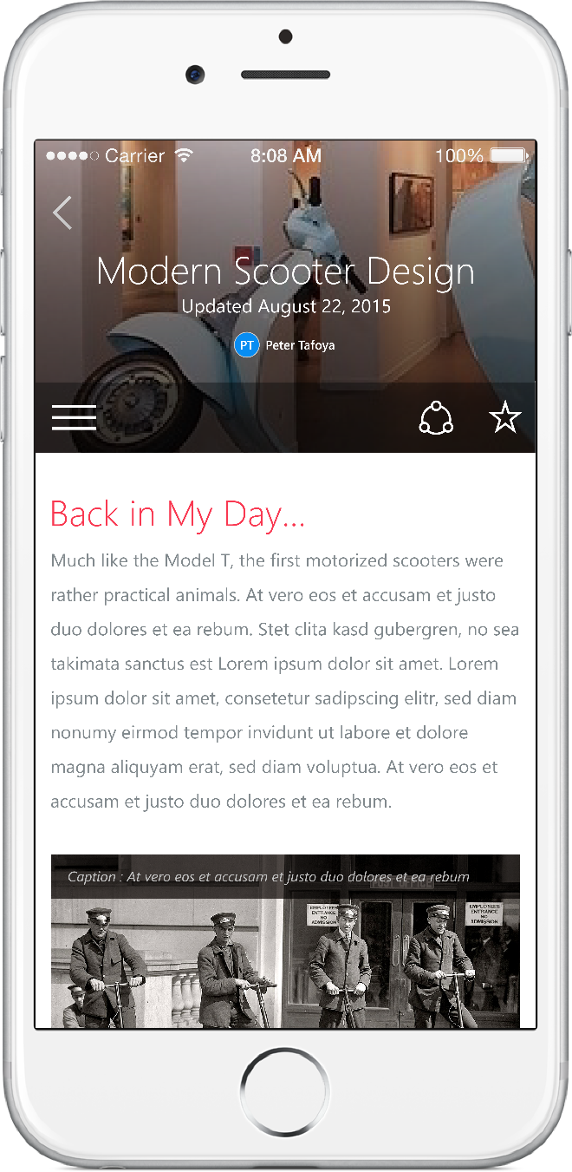
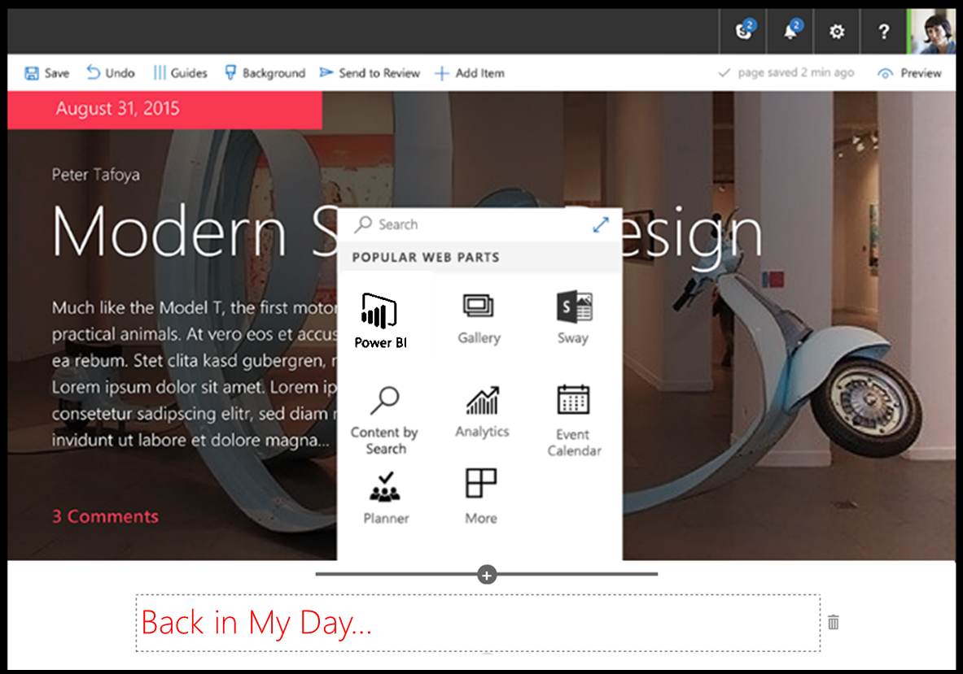
SharePoint Framework
Modern client-side development
Lightweight web and mobile
Powers our own experiences
Backward compatible
Supports open source tools & JavaScript web frameworks
SharePoint Framework
Microsoft Graph
LOB Systems and Cloud Services
Notes:
Built into the SharePoint mobile apps

Slide 10
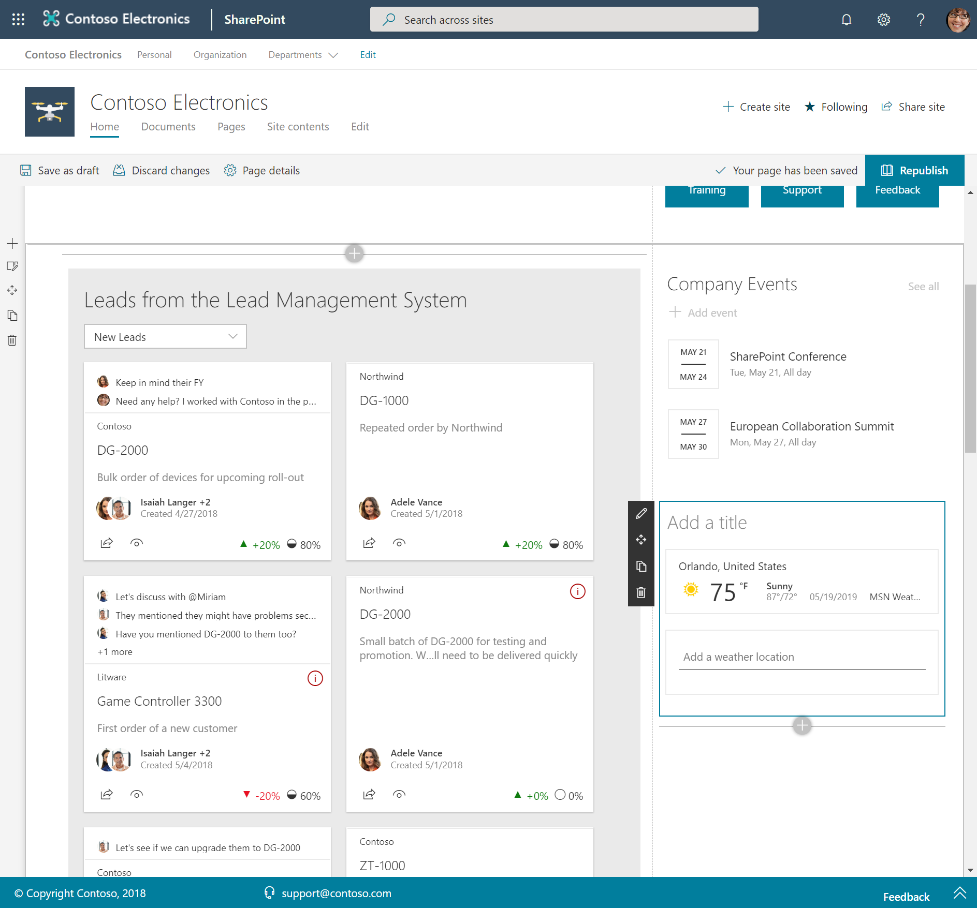
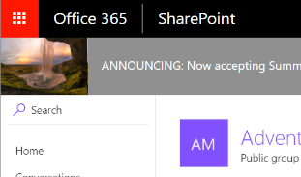
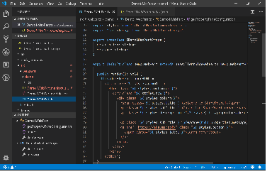
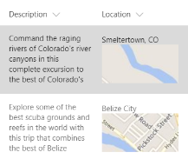
SharePoint Framework component types
Web Parts
Extensions
Libraries

Slide 11
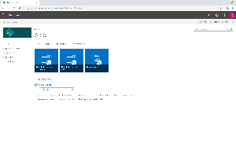
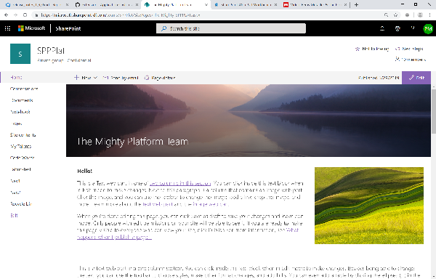
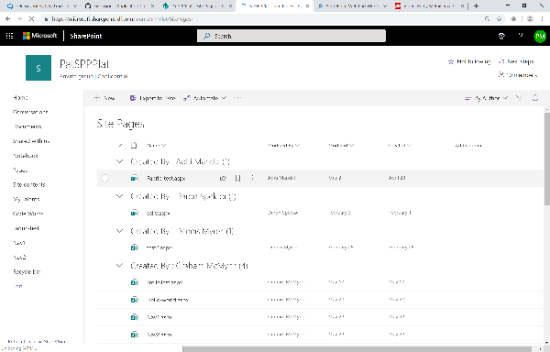
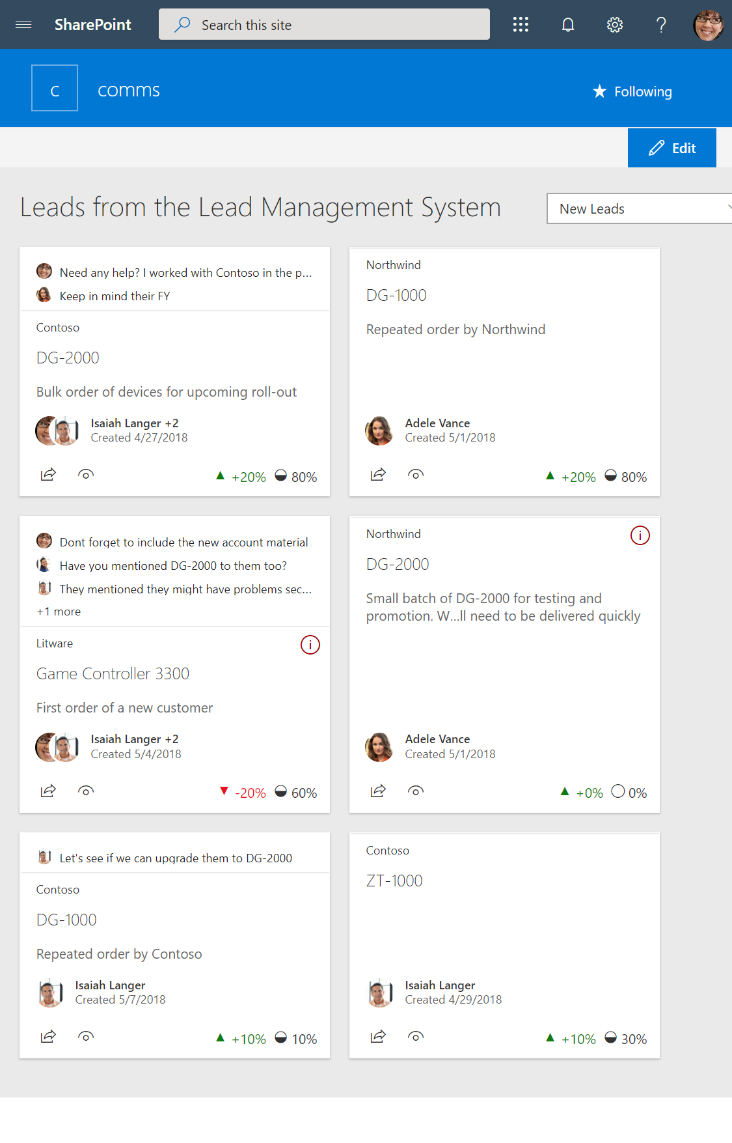
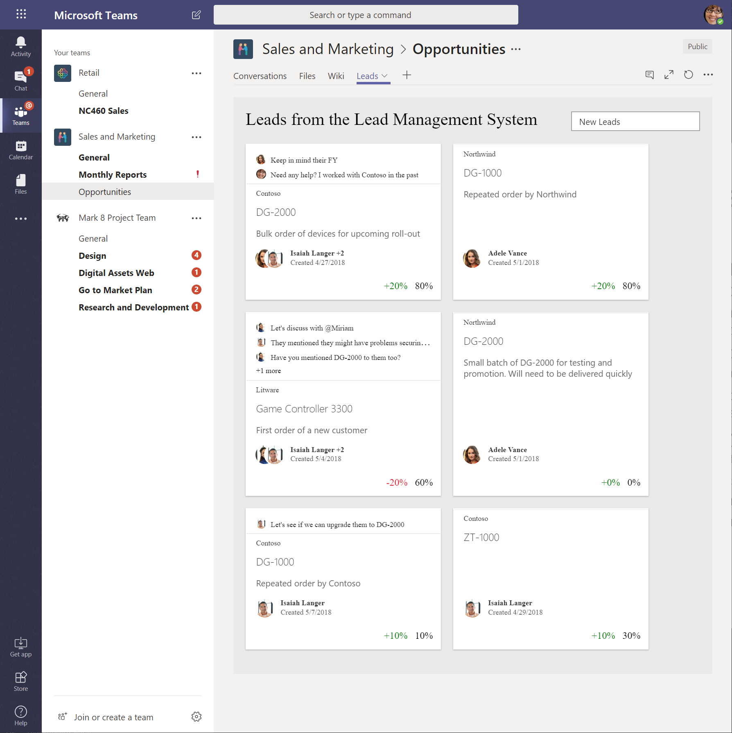
SharePoint Framework Hosted Scenarios
Classic Pages
Modern Pages
Lists and Libraries
App pages
Teams Tabs
Web Parts
Web Parts
Extensions
Web Parts
Web Parts
Extensions
Extensions
Library components work in all hosted platforms

Slide 12

What’s a modern page?
Client-side rendered
Natively responsive
Client-side web parts
Client-side and persisted caches
Mobile optimized
Notes:
Client-side rendered using Open Source web tech
CDN deployed web apps with client side interactivity and fast page routing
Client-side web parts
Client-side and persisted caches
Mobile optimized (responsive)

Slide 13
Modern Site Pages
Easily create powerful, beautiful looking pages
Communicate ideas and information using our new authoring canvas and gallery of web parts.
Modern building blocks
Authoring canvas and web parts are built using client-side HTML and JavaScript. Pages are reusable in custom applications
Mobile support is built in from the start
Content reflows across device sizes and pages are fast and fluid.
Pages get better with the Microsoft Graph
Authors can leverage Microsoft Graph to surface relevant pages to the people that need to read them.

Slide 14
Agenda
Module 2: Preparing your machine for the SPFx
Setup Office 365
Create AppCatalog
Visual Studio Code
Node.js/NPM – local hosting and module management
Yeoman – project scaffolding
Gulp – task runner

Slide 15
Office 365 Developer Tenant Setup Steps
Sign up for an Office 365 Developer Tenant
Create app catalog site
Create a new site collection for testing – dev or normal
1-2-3
Notes:
To build and deploy client-side web parts using the the SharePoint Framework, you will need an Office 365 Tenant.

Slide 16
Join the Office 365 Developer Program!
Setup Office 365
Go to https://developer.microsoft.com/en-us/office/dev-program
Signup for a free 12-month office 365 developer subscription
Refer below document
Lab 1 - Set up a Microsoft 365 E5 Developer subscription .docx
Notes:
To build and deploy client-side web parts using the the SharePoint Framework, you will need an Office 365 Tenant.

Slide 17
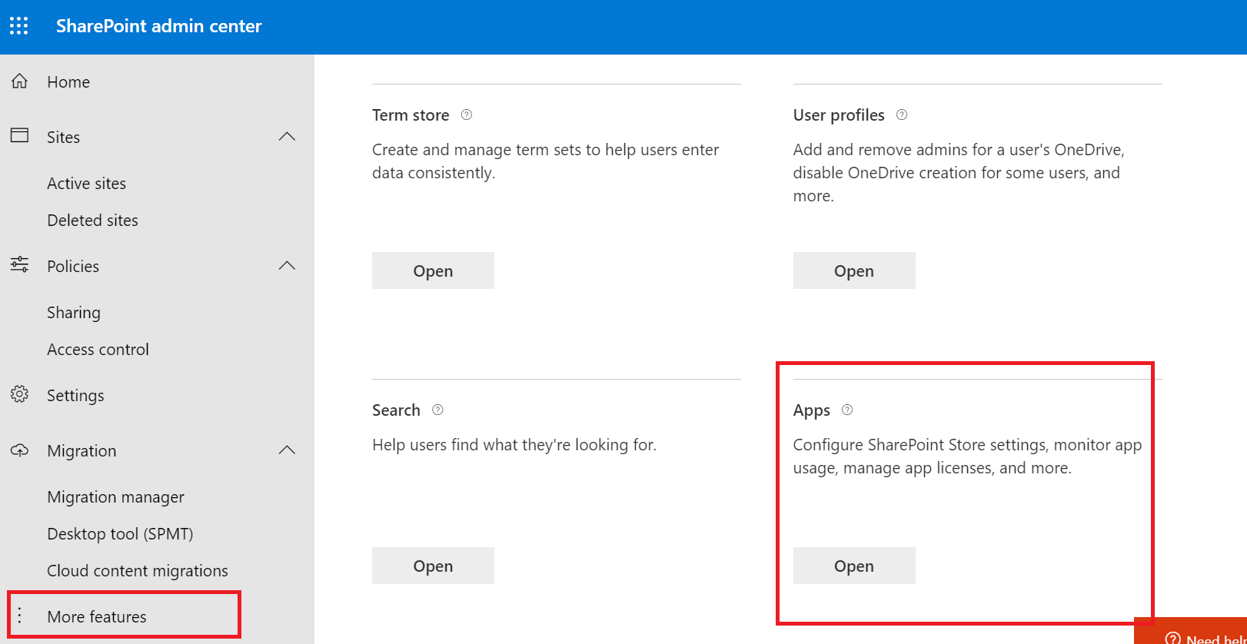
Create App Catalog Site
https://[tenant]-admin.sharepoint.com
SharePoint Framework solutions are deployed to an app catalog when they are ready for distribution

Slide 18
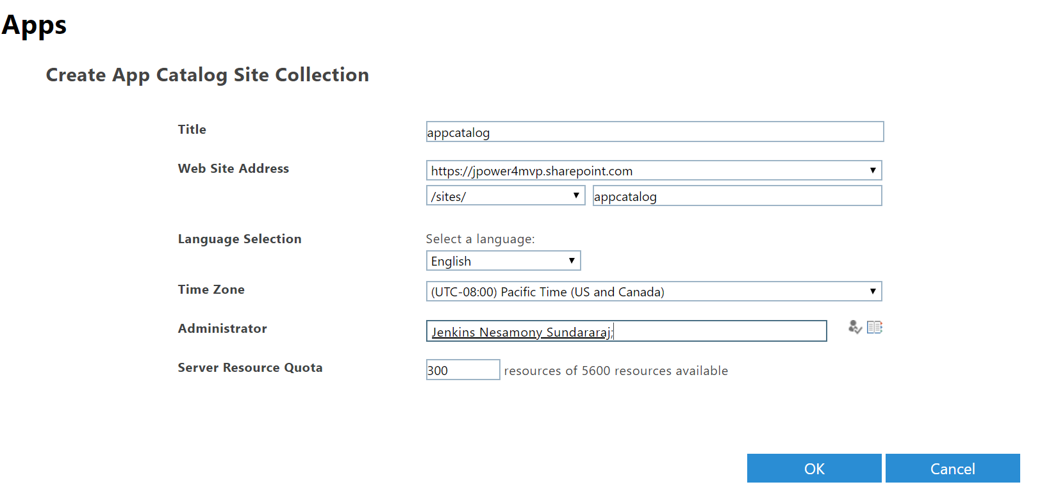
Create App Catalog Site
Refer below document
Lab 2 - Create the App Catalog site collection.docx

Slide 19
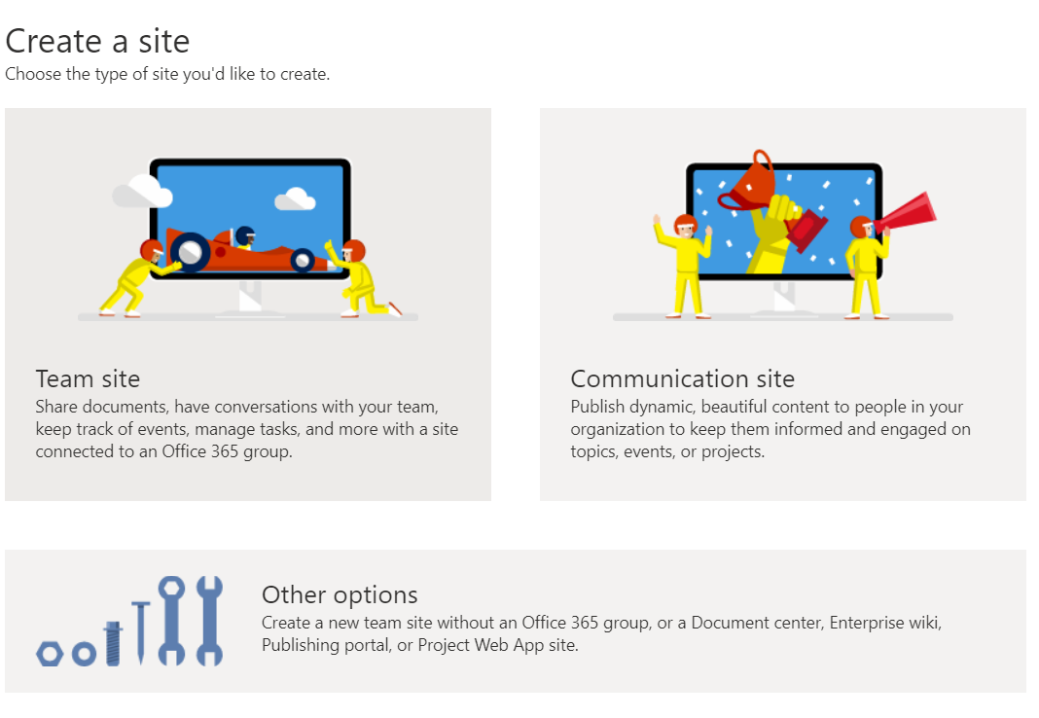
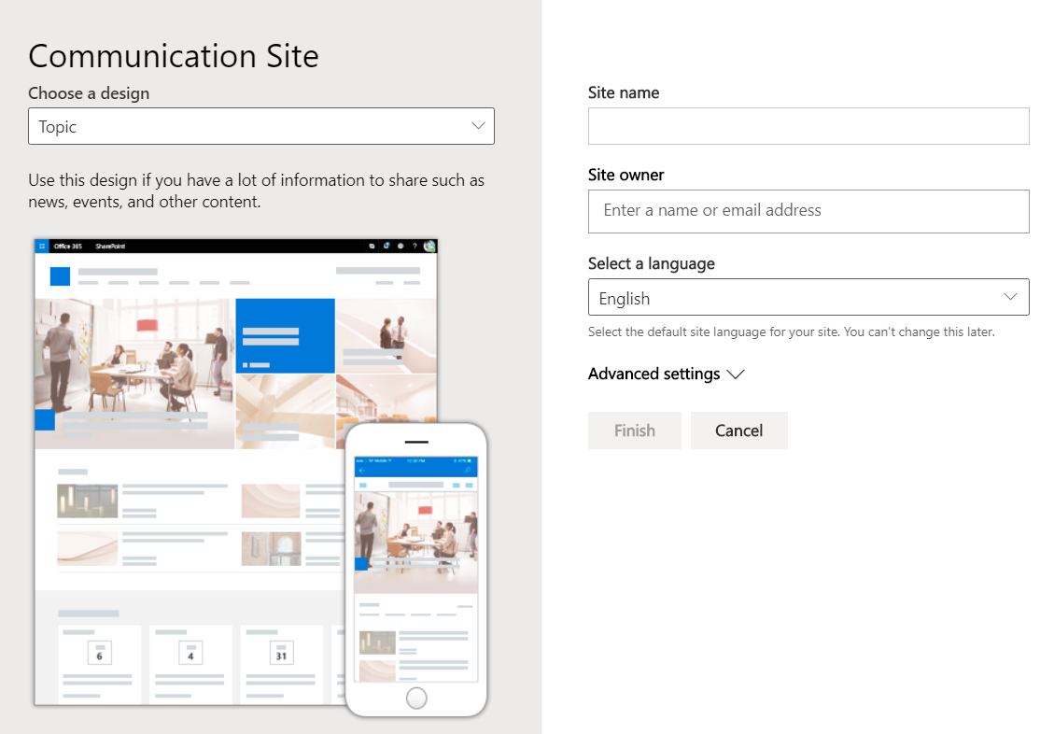
Create a new Development Site collection
https://[tenant]-admin.sharepoint.com
Use this site collection to test web parts and extensions

Slide 20
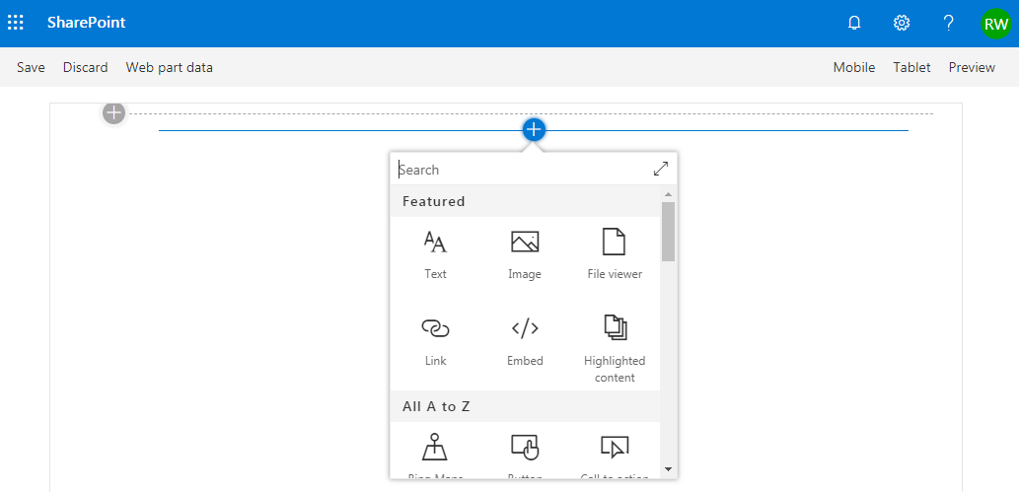
SharePoint Online Hosted Workbench
https://[sharpeointonline-site]/_layouts/workbench.aspx
SharePoint Online workbench can be accessed under any site with _layouts URL. Hosted site provides you site context where solution is executed.

Slide 21

Configuring your SPFx Development Environment
Tool Comparison: Server-side vs. client-side
Node.js
NPM, Yeoman, Gulp
TypeScript

Slide 22






Open source tooling
SharePoint Framework leverages an open source, Node.js based toolchain and embraces all web frameworks + code editors
Build Process & Tooling
Yeoman Templates
Gulp (task runner)
Node.js
NPM (package manager)
SystemJS
Webpack
SASS
TypeScript
Web Frameworks
React
Angular
Knockout
jQuery
… and more… your choice!
Code Editors
Visual Studio Code
Atom
Sublime
Webstorm
… and more… your choice!

Slide 23


Server-side tool comparison
IIS Express
C#
MSBuild
Project Templates

Slide 24
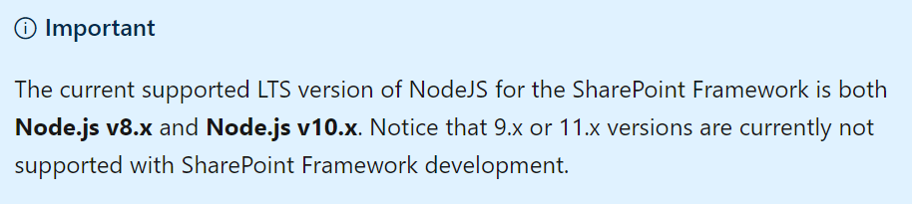
Node.js - Runtime
Cross platform JavaScript runtime
Similar to .NET Framework is a runtime for C# based projects
Used to execute JavaScript on the desktop / server / devices
API wrapper to Chromes V8 JavaScript engine
SPFx’s open source tooling is built on Node.js
SPFx supports Node.js LTS v8.* and v10.*
LTS: Long term support
https://nodejs.org/

Slide 25
NPM – Node Package Manager
NPM is a package manager for Node.js based projects
Similar to NuGet that is the .NET Framework package manager
Client tool used to acquire packages from the NPM registry: https://www.npmjs.com
Similar to NuGet that’s the client tool for the NuGet registry: https://www.nuget.org
Included with the default Node.js install
https://www.npmjs.com

Slide 26
Yeoman – Project Scaffolding Generator
Scaffolding engine that executes generators
Generators prompt user with questions
Generates project scaffolding (folders & files) for projects
Microsoft provides SharePoint Framework generator
Installed on your dev environment with NPM
npm install -g yo
npm install -g @microsoft/generator-sharepoint
http://yeoman.io

Slide 27
Gulp – Task Runner
Gulp is a task runner for projects
Similar to MSBuild that is the .NET Framework task runner
Tasks are defined with JavaScript
Similar to MSBuild tasks defined in XML
Performs common tasks: compile, package, start test process, etc.
Microsoft has created all required tasks
npm install -g gulp
http://gulpjs.com

Slide 28
TypeScript – Typed JavaScript
Typed superset of JavaScript
Compiles to plain JavaScript
Development language for the base templates in SharePoint Framework projects
You can also integrate native JavaScript to SharePoint Framework customizations *
No need to rewrite everything
Version of TypeScript supported by SPFx included in each SPFx project
https://www.typescriptlang.org

Slide 29
Validate local SPFx development configuration
Install required runtimes & tools:
Node.js & NPM (included with Node.js)
Yeoman, SPFx Yeoman generator
Gulp
Create first project with Yeoman & SPFx generator
Build & run web part in the local workbench
yo @microsoft/sharepoint
gulp serve

Slide 30
Demo
Creating & Running Your First SPFx Project

Slide 31
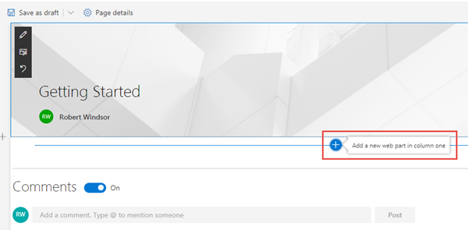
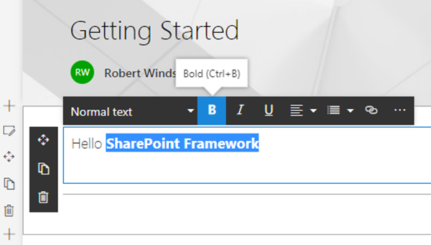
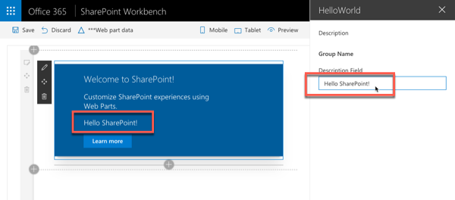
Adding SPFx web parts to pages
Once a page is in edit mode, add via web part toolbox
Select a web part and edit inline or using the property pane

Slide 32
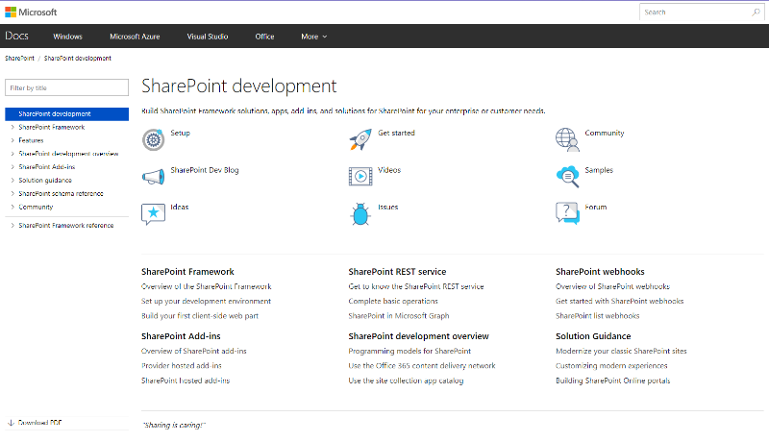
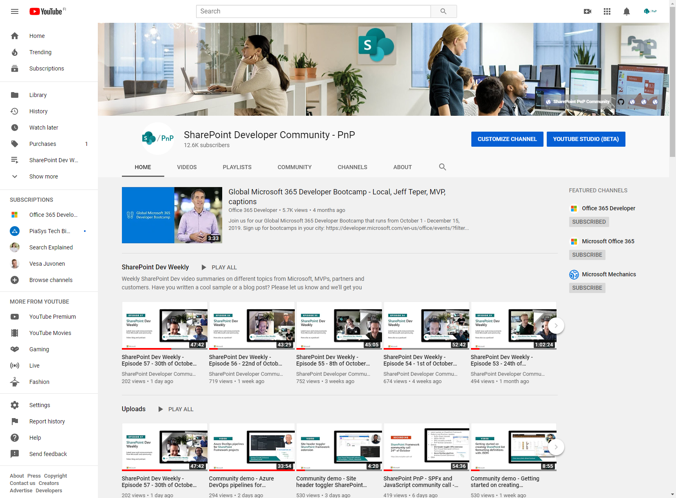
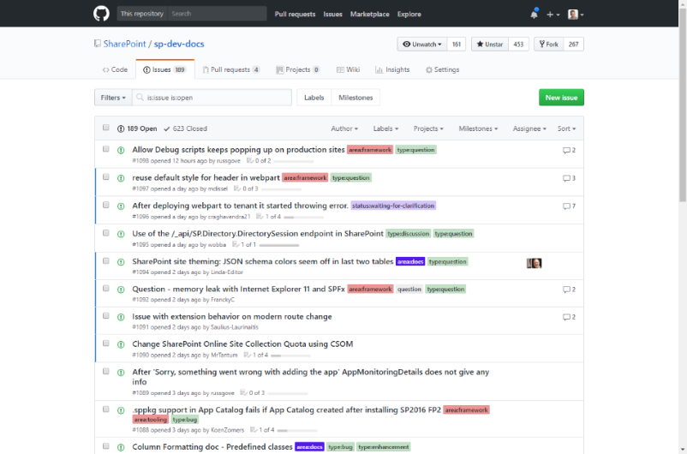
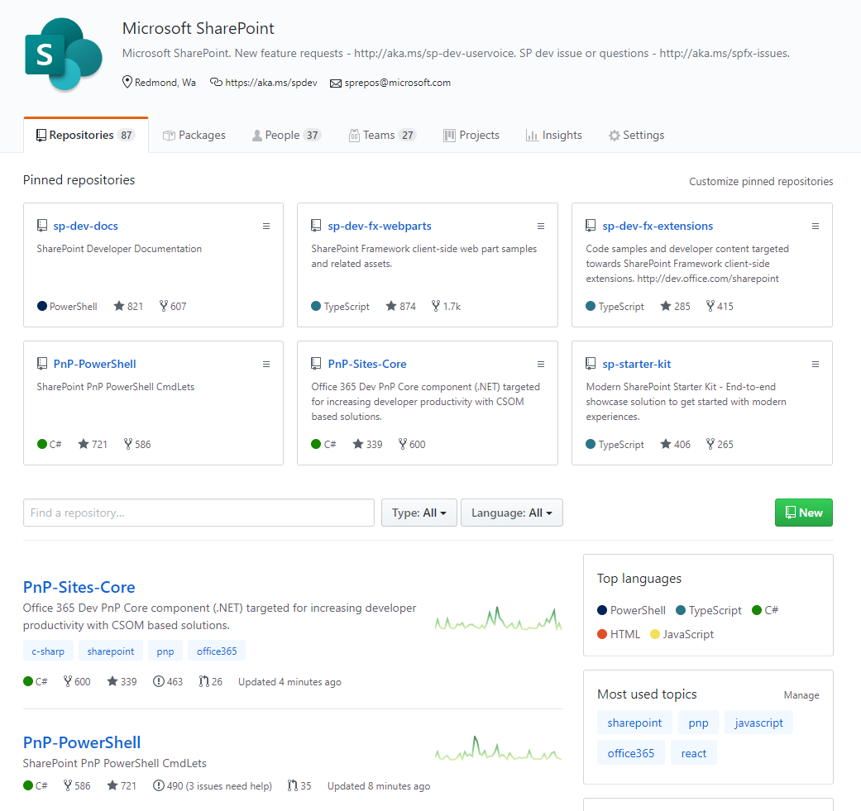
SharePoint Dev docs
SharePoint (Dev) videos
SharePoint Dev issues
Open-source
aka.ms/spdev-docs
aka.ms/spdev-videos
aka.ms/spdev-issues
github.com/sharepoint
github.com/pnp

Slide 33
References
Overview of the SharePoint Framework
https://docs.microsoft.com/sharepoint/dev/spfx/sharepoint-framework-overview
Overview of SharePoint Framework Extensions
https://docs.microsoft.com/sharepoint/dev/spfx/extensions/overview-extensions
Use Page Placeholders from Application Customizer
https://docs.microsoft.com/sharepoint/dev/spfx/extensions/get-started/using-page-placeholder-with-extensions
Tenant Wide Deployment of SharePoint Framework Extensions
https://docs.microsoft.com/sharepoint/dev/spfx/extensions/basics/tenant-wide-deployment-extensions
Build your First Field Customizer Extension
https://docs.microsoft.com/sharepoint/dev/spfx/extensions/get-started/building-simple-field-customizer
Build your First ListView Command Set extension
https://docs.microsoft.com/en-us/sharepoint/dev/spfx/extensions/get-started/building-simple-cmdset-with-dialog-api

Slide 34



Official Blog
dev.office.com/blogs
Twitter
@OfficeDevPnP
Tech Community
aka.ms/sppnp-community

